Slide 1
Chapter 2: Logic and Its Applications
1

Slide 2
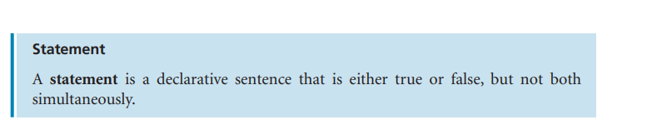
What is statement
lick to add text

Slide 3
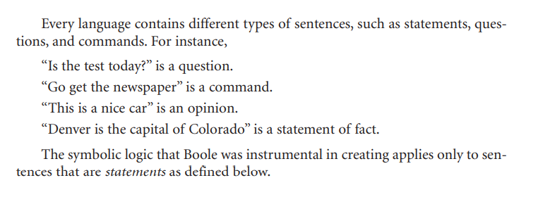
What is statement ? Explanation
lick to add text

Slide 4
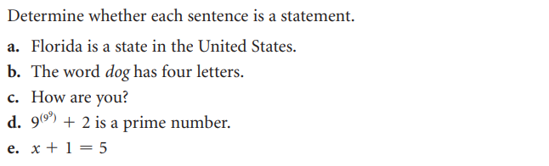
Identify Statement

Slide 5
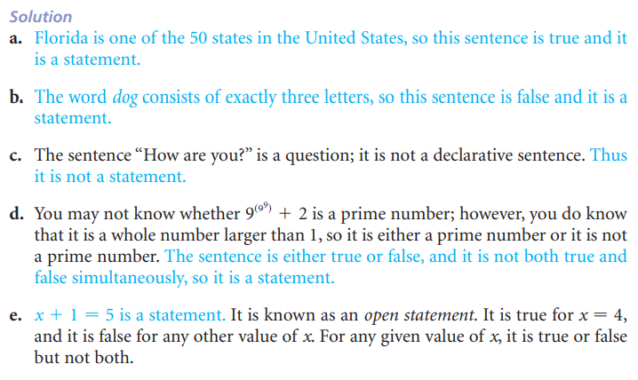
Identify Statement

Slide 6
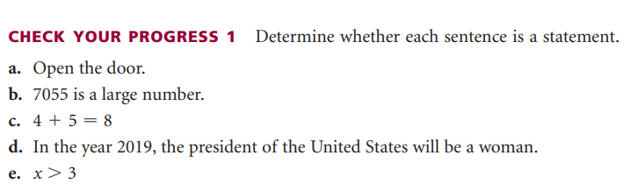
Identify Statement

Slide 7
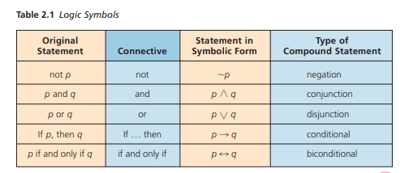
Connectives for Compound Statements
Connecting statements with words and phrases such as and, or, not, if … then, and if and only if creates a compound statement.
Example: “I will attend the meeting or I will go to school” is a compound statement.
It is composed of the two component statements “I will attend the meeting” and “I will go to school.” The word or is a connective for the two component statements.

Slide 8
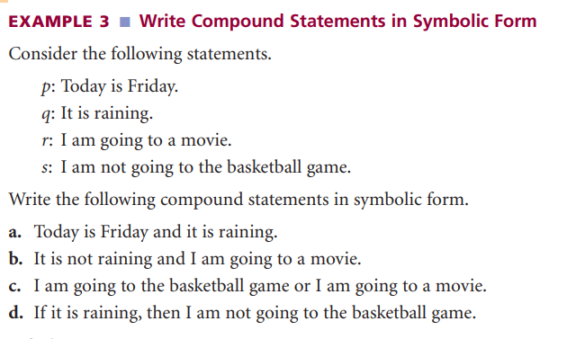

Slide 9
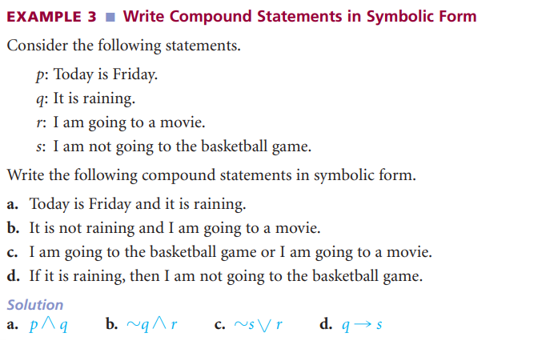

Slide 10
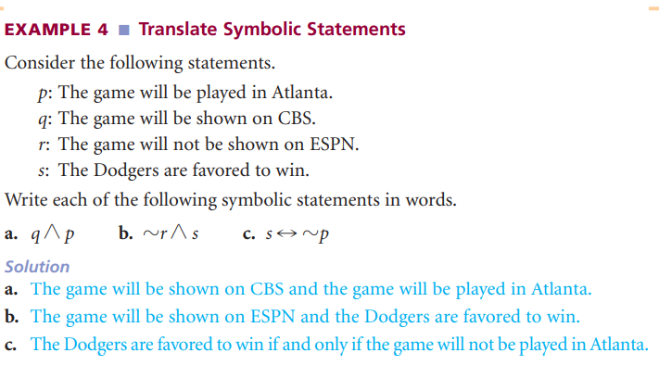

Slide 11
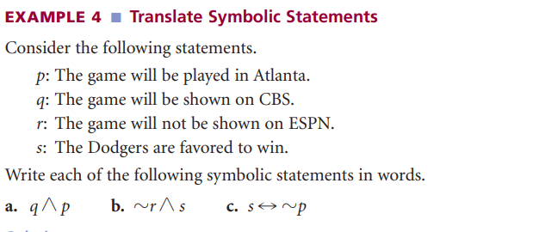

Slide 12
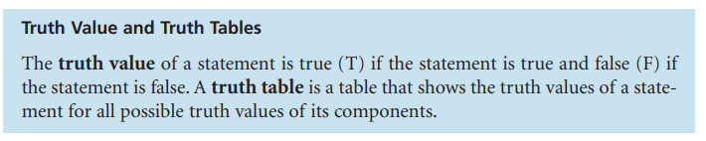

Slide 13

Negation of a Statement
The negation of the statement “Today is Friday” is the statement “Today is not Friday.”
In symbolic logic, the tilde symbol ( ~ ) is used to denote the negation of a statement.
If a statement p is true, its negation is false, and if a statement p is false, its negation is true.

Slide 14
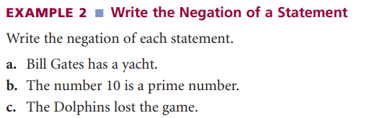

Slide 15
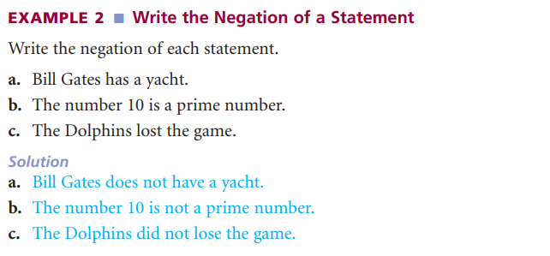

Slide 16
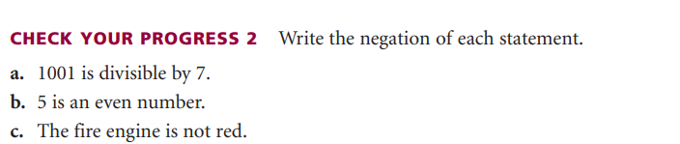

Slide 17
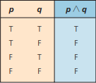
Conjunction of two Statements
Zain ordered cake and ice cream in a restaurant for a friend’s birthday. The waiter brought both cake and ice cream.
In general, the conjunction is true if both p and q are true, and the conjunction is false if either p or q is false.

Slide 18
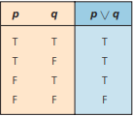
Disjunction of two Statements
Any disjunction is true if p is true or q is true or both p and q are true.
The truth table below shows that the disjunction p or q is false if both p and q are false; however, it is true in all other cases.

Slide 19
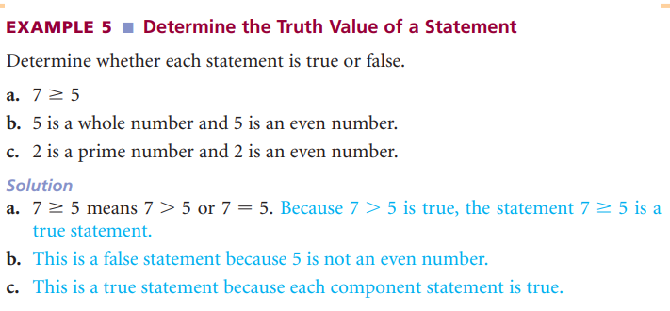

Slide 20
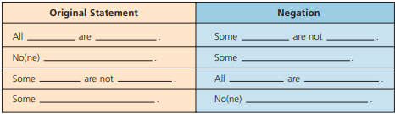
Quantifiers and Negation
In a statement, the word some and the phrases there exists and at least one are called existential quantifiers. Existential quantifiers are used as prefixes to assert the existence of something.
In a statement, the words none, no, all, and every are called universal quantifiers. The universal quantifiers none and no deny the existence of something, whereas the universal quantifiers all and every are used to assert that every element of a given set satisfies some condition.

Slide 21
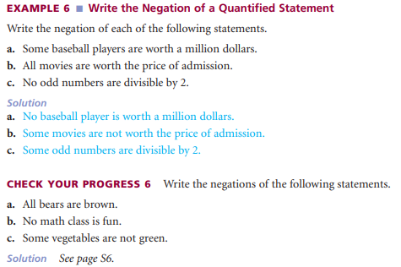
Quantifiers and Negation

Slide 22
To test the validity of an argument, we use the following three-step process:
Symbolize each premise and the conclusion.
2. Make a truth table that has a column for each premise and a column for the conclusion.
3. If the truth table has a row where the conclusion column is FALSE while every premise column is TRUE, then the argument is INVALID. Otherwise, the argument is VALID.

Slide 23
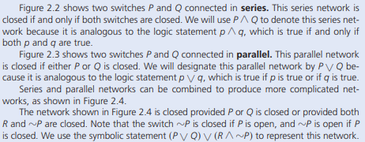
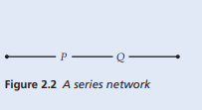
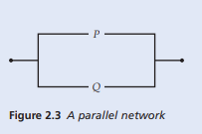
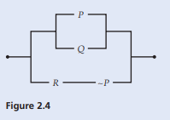
Switching Network

Slide 24
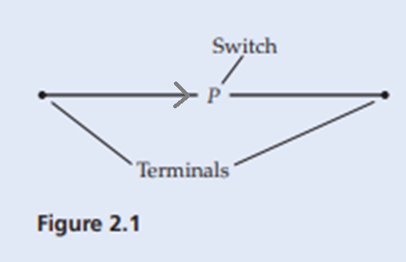
Switching Network
A switching network consists of wires and switches that can open or close.
Switching networks are used in many electrical appliances, telephone equipment, and computers.
Figure 2.1 shows a switching network that consists of a single switch P that connects two terminals.
An electric current can flow from one terminal to the other terminal provided the switch P is in the closed position.
If P is in the open position, then the current cannot flow from one terminal to the other.
If a current can flow between the terminals we say that a network is closed, and if a current cannot flow between the terminals we say that the network is open.
We designate this network by the letter P. There exists an analogy between a network P and a statement p in that a network is either open or closed, and a statement is either true or false.

Slide 25


Switching Network
If two switches are always open at the same time and always closed at the same time, then we will use the same letter to designate both switches.
Practice: Write symbolic statements for each of these switching networks:
1. (s) /\ (-R V –Q V p)
2. ( -p v q) /\ (-R v S)

Slide 26
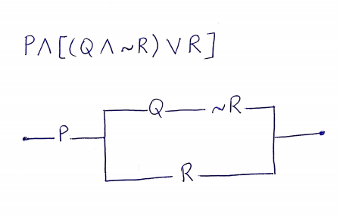
Switching Network
Practice: Draw a network to represent the given statement.:

Slide 27
Switching Network
Practice: Draw a network to represent each statement.:
1.
2.
3.

